Slide 1

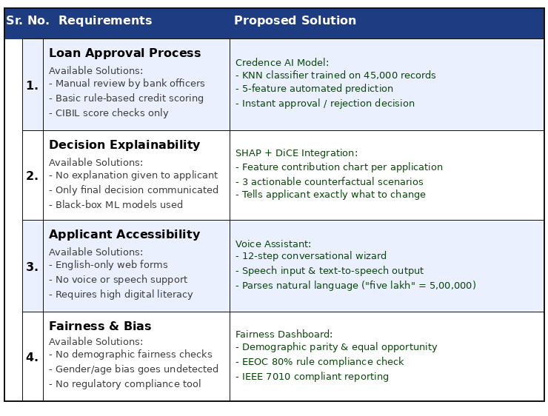
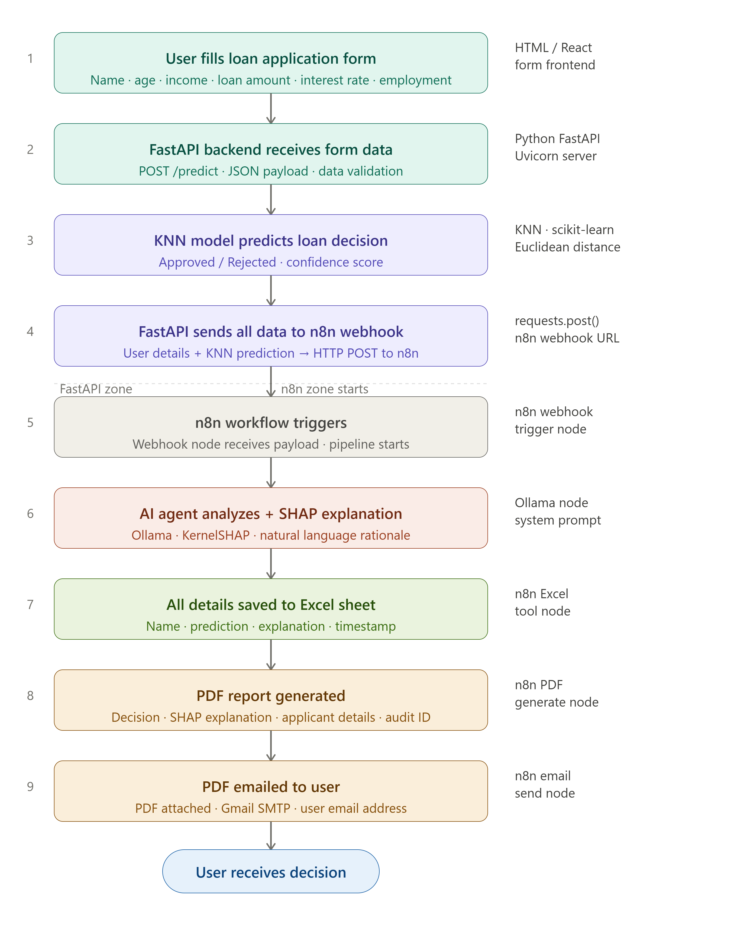
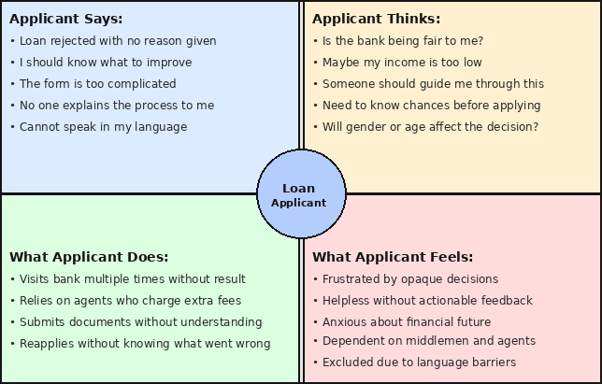
Proposed Architecture/ Diagram:
IEEE Summer Research Internship
Class :
Group Id: 01
DEPARTMENT OF COMPUTER SCIENCE & ENGINEERING
Credence — AI Loan Approval System
Explainable KNN Model with Voice Assistant & Fairness Dashboard
Names : Shivani Suryawanshi , Sejal Kaldate , Shreya Patil
Faculty Guide:
Dr. Seema.V. Kedar
Block Diagram
Proposed Solution
Credence: KNN model trained on 45,000 records, 5 features.
SHAP — explains why each decision was made
DiCE — 3 "what to change" scenarios for rejected applicants
- EMI & DTI — live financial calculator in the form
- Voice Assistant — 12-step wizard, speech input & output
- Fairness Dashboard — EEOC 80% rule, IEEE 7010 compliant
Scope and Feasibility
4 Modules:
1. Prediction — AI model decides loan approval instantly
2. Explainability — tells you why it was approved or rejected
3. Voice Assistant — talk to the system in your language
4. Fairness Check — ensures no bias based on gender or age
Problem statement
Loan approval in India is manual, opaque, and biased.
Applicants get no explanation for rejection and no
guidance to improve. Existing ML models are black boxes
— accurate but not transparent, fair, or accessible.

